Slide 1
1
Unit III Data Warehouse

Slide 2

Unit III Data Warehouse Business Intelligence and Data Analytics
Mrs. Madhuri Prashant Karnik
madhuri.chavan@viit.ac.in
Department of Computer Engineering
BRACT’S, Vishwakarma Institute of Information Technology, Pune-48
(An Autonomous Institute affiliated to Savitribai Phule Pune University)
(NBA and NAAC accredited, ISO 9001:2015 certified)

Slide 3
3
Topics
Introduction
Data Warehouse Modeling: Data Cube and OLAP Data Warehouse Design and Usage
Distributed Data-warehouse and materialized view
Different types of OLAP and their applications
Difference between OLAP and OLTP
Big Data Lakes
Department of Computer Engineering, VIIT , Pune-48

Slide 4
4
Data warehouse
A data warehouse is a repository (or archive) of information gathered from multiple sources, stored under a unified schema, at a single site.
Once gathered, the data are stored for a long time.
Thus, data warehouses provide the user a single combined interface to data, making decision-support queries easier to write.

Slide 5
What is Data Warehouse?
Defined in many different ways, but not rigorously.
A decision support database that is maintained separately from the organization’s operational database
Support information processing by providing a solid platform of consolidated, historical data for analysis.
“A data warehouse is a subject-oriented, integrated, time-variant, and nonvolatile collection of data in support of management’s decision-making process.”—W. H. Inmon
8/29/2020
5
Notes:
5
5

Slide 6
6
What is Data Warehouse?
“A data warehouse is a subject-oriented, integrated, time-variant, and nonvolatile collection of data in support of management’s decision-making process.”—W. H. Inmon (father of data warehousing).
A data warehouse is simply a single, complete, and consistent store of data obtained from a variety of sources and made available to end users in a way they can understand and use it in a business context
Data warehousing:
The process of constructing and using data warehouses.
Notes:
6

Slide 7
7
Data Warehouse—Subject-Oriented
The Data warehouse is subject oriented because it provide us the information around a subject rather the organization's ongoing operations.
These subjects can be product, customers, suppliers, sales etc.
The data warehouse does not focus on the ongoing operations rather it focuses on modeling and analysis of data for decision making.
Provide a simple and concise/brief view around particular subject issues by excluding data that are not useful in the decision support process.

Slide 8
8
Data Warehouse—Integrated
Data Warehouse is constructed by integration of data from heterogeneous sources such as relational databases, on-line transaction records etc.
This integration enhance the effective analysis of data.
Data cleaning and data integration techniques are applied.
Ensure consistency in naming conventions, encoding structures, attribute measures, etc. among different data sources
When data is moved to the warehouse, it is converted.

Slide 9
9
Data Warehouse—Time Variant
The Data in Data Warehouse is identified with a particular time period. The data in data warehouse provide information from historical point of view.
The time horizon /scope for the data warehouse is significantly longer than that of operational systems
Operational database: current value data
Data warehouse data: provide information from a historical perspective (e.g., past 5-10 years)
Every key structure in the data warehouse
Contains an element of time
But the key of operational data may or may not contain “time element”

Slide 10
10
Data Warehouse—Nonvolatile
Non volatile means that the previous data is not removed when new data is added to it.
The data warehouse is kept separate from the operational database therefore frequent changes in operational database is not reflected in data warehouse, that is a physically separate store of data transformed from the operational environment.
Operational update of data does not occur in the data warehouse environment
Does not require transaction processing, recovery, and concurrency control mechanisms
Data warehouse is read only.
Requires only two operations in data accessing:
initial loading of data and access of data

Slide 11
11
Data Warehouse—Metadata
Metadata is simply defined as data about data.
The data that are used to represent other data is known as metadata.
For example the index of a book serve as metadata for the contents in the book.
It means the metadata is the summarized data that lead us to the detailed data.

Slide 12
12
Operational Data
It is used to run the buisness.
This data is typically stored,retrived and updated by OLTP(Online Transaction Processing) system.
Example of OLTP: a reservation system, an accounting application, or an order-entry application.

Slide 13
13
Informational Data
It is created from operational data.
Informational data is typically
-summarized operational data.
-Denormalized and replicated data.
-possibly read only
-Stored on separate systems etc.

Slide 14
14
Why Data Warehouse Separated from Operational Databases?
The operational database is constructed for well known tasks and workload such as searching particular records, indexing etc but the data warehouse queries are often complex and it presents the general form of data.
Operational databases supports the concurrent processing of multiple transactions. Concurrency control and recovery mechanism are required for operational databases to ensure robustness and consistency of database.
Operational database query allow to read, modify operations while the OLAP query need only read only access of stored data.
Operational database maintain the current data on the other hand data warehouse maintain the historical data.

Slide 15
15
Why Separate Data Warehouse?
DBMS— tuned for OLTP: access methods, indexing, concurrency control, recovery.
Warehouse—tuned for OLAP: complex OLAP queries, multidimensional view, consolidation.
Different functions and different data:
missing data: Decision support requires historical data which operational DBs do not typically maintain
data consolidation: DBs requires consolidation (aggregation, summarization) of data from heterogeneous sources
data quality: different sources typically use inconsistent data representations, codes and formats which have to be reconcile

Slide 16
Data Warehouse: A Multi-Tiered Architecture
Monitor
&
Integrator
OLAP Server
Other
sources
Metadata
Analysis
Query/
Reports
Data mining
Operational
DBs
Extract
Transform
Load
Refresh
Data
Warehouse
Serve
Data Marts
Data Sources
Data Storage
OLAP Engine
Front-End Tools

Slide 17
17
Data Warehouse Back-End Tools and Utilities
Data extraction
get data from multiple, heterogeneous, and external sources
Data cleaning
detect errors in the data and rectify them when possible
Data transformation
convert data from host format to warehouse format
Load
sort, summarize, consolidate, compute views, check integrity, build and partitions
Refresh
propagate (transmit) the updates from the data sources to the warehouse

Slide 18
18
Three-Tier Architecture
Warehouse database server
Almost always a relational DBMS, unstructured data.
OLAP servers
Relational OLAP (ROLAP): extended relational DBMS that maps operations on multidimensional data to standard relational operations.
Multidimensional OLAP (MOLAP): special purpose server that directly implements multidimensional data and operations.
Clients
Query and reporting tools
Analysis tools
Data mining tools (e.g., trend analysis, prediction)
Notes:
18

Slide 19
19
Three Data Warehouse Models
Enterprise warehouse
It contains detailed data as well as summarized data.
The enterprise warehouse collects all the information all the subjects spanning the entire organization
This provide us the enterprise-wide data integration.
The data is integrated from operational systems and external information providers.
This information can vary from a few gigabytes to hundreds of gigabytes, terabytes or beyond.

Slide 20
20
Data Mart
a subset of corporate-wide data that is of value to a specific groups of users.
in other words we can say that data mart contains only that data which is specific to a particular group.
Its scope is confined to specific, selected groups, such as marketing data mart
For example the marketing data mart may contain only data related to item, customers and sales.

Slide 21
21
Virtual warehouse
A set of views over operational databases
Only some of the possible summary views may be materialized.
The view over a operational data warehouse is known as virtual warehouse.
Building the virtual warehouse requires excess capacity on operational database servers.

Slide 22
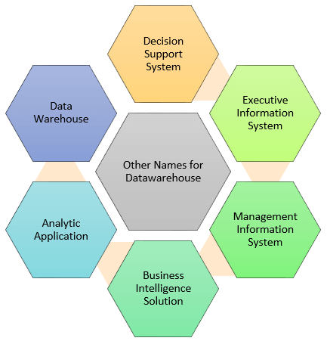
Other name of DWH (ref:guru99.com)

Slide 23
DWH examples(ref:guru99.com)
Airline:
In the Airline system, it is used for operation purpose like crew
assignment, analyses of route profitability,
frequent flyer program promotions, etc.
Banking:
It is widely used in the banking sector to manage the resources
available on desk effectively.
Few banks also used for the market research, performance
analysis of the product and operations.
Healthcare:
Healthcare sector also used Data warehouse to strategize and
predict outcomes, generate patient's treatment reports,
share data with tie-in insurance companies, medical aid services, etc.

Slide 24
Applications
Public sector:
In the public sector, data warehouse is used for intelligence gathering.
It helps government agencies to maintain and analyze tax records, health policy records,
for every individual.
Investment and Insurance sector:
In this sector, the warehouses are primarily used to analyze data patterns,
customer trends, and to track market movements.
Retain chain:
In retail chains, Data warehouse is widely used for distribution and marketing.
It also helps to track items, customer buying pattern, promotions and also used for
determining pricing policy.
Telecommunication:
A data warehouse is used in this sector for product promotions, sales decisions
and to make distribution decisions.
Hospitality Industry:

Slide 25
Task of DWH
Tasks | Deliverables
1 | Need to define project scope | Scope Definition
2 | Need to determine business needs | Logical Data Model
3 | Define Operational Datastore requirements | Operational Data Store Model
4 | Acquire or develop Extraction tools | Extract tools and Software
5 | Define Data Warehouse Data requirements | Transition Data Model
6 | Document missing data | To Do Project List
7 | Maps Operational Data Store to Data Warehouse | D/W Data Integration Map
8 | Develop Data Warehouse Database design | D/W Database Design
9 | Extract Data from Operational Data Store | Integrated D/W Data Extracts
10 | Load Data Warehouse | Initial Data Load
11 | Maintain Data Warehouse | On-going Data Access and Subsequent Loads

Slide 26
DWH tools
Cdata Sync
Query Surge
Xplentry
Oracle
Amazon redshift
Panoply

Slide 27
Domo
Teradata Corporation
Informatica
SAP/SAS
Tabaleu
Pentaho

Slide 28
28
Data Warehouse Usage
Three kinds of data warehouse applications
Information processing
supports querying, basic statistical analysis, tables, charts and graphs
Analytical processing
multidimensional analysis of data warehouse data
supports basic OLAP operations, slice-dice, drilling, pivoting
Data mining
knowledge discovery from hidden patterns
supports associations, constructing analytical models, performing classification and prediction, and presenting the mining results using visualization tools

Slide 29
29
Data Warehouse Schemas
Data warehouses typically have schemas that are designed for data analysis, using tools such as OLAP tools.
Thus, the data are usually multidimensional data, with dimension attributes and measure attributes.
Tables containing multidimensional data are called fact tables and are usually very large.
A table recording sales information for a retail store, with one tuple for each item that is sold, is a typical example of a fact table.

Slide 30
30
The dimensions of the sales table would include what the item is (usually an item identifier such as that used in bar codes), the date when the item is sold, which location (store) the item was sold from, which customer bought the item, and so on. The measure attributes may include the number of items sold and the price of the items.
To minimize storage requirements, dimension attributes are usually short identifiers that are foreign keys into other tables called dimension tables.

Slide 31
31
For instance, a fact table sales would have attributes item id, store id, customer id, and date, and measure attributes number and price.
The attribute store id is a foreign key into a dimension table store, which has other attributes such as store location (city, state, country).
The item id attribute of the sales table would be a foreign key into a dimension table item info, which would contain information such as the name of the item, the category to which the item belongs, and other item details such as color and size.

Slide 32
32
The customer id attribute would be a foreign key into a customer table containing attributes such as name and address of the customer.
Similarly the date attribute as a foreign key into a date info table giving the month, quarter, and year of each date.

Slide 33
33
Example of Star Schema
time
time_key
day
day_of_the_week
month
quarter
year
item
item_key
item_name
brand
type
supplier_type
Sales Fact Table
time_key
item_key
branch_key
branch
location
location_key
branch_key
branch_name
branch_type
location_key
street
city
state_or_province
country
units_sold
dollars_sold
avg_sales
Measures

Slide 34
What type of queries u can retrieve from the SALE star schema
Total unit sold: Branch wise, monthly, Itemwise, Location wise
Average sale: Branch wise, Locationwise, Itemwise
What is the average sale of India?
Average sale more than 1 lakh in Maharashtra
Avarage quarterly sale in India
Average sale more than average sale of Rajasthan

Slide 35
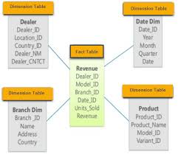
Example2

Slide 36
36
Such a schema, with a fact table, multiple dimension tables, and foreign keys from the fact table to the dimension tables, is called a star schema.
More complex data-warehouse designs may have multiple levels of dimension tables;
For example, the item info table may have an attribute manufacturer id that is a foreign key into another table giving details of the manufacturer.
Such schemas are called snowflake schemas.
Complex data warehouse designs may also have more than one fact table.

Slide 37
37
Example of Snowflake Schema
time
item
time_key
day
day_of_the_week
month
quarter
year
item_key
item_name
brand
type
supplier_key
supplier
Sales Fact Table
supplier_key
supplier_type
time_key
item_key
branch_key
branch
location
location_key
location_key
street
city_key
branch_key
branch_name
branch_type
units_sold
dollars_sold
city
city_key
city
state_or_province
country
avg_sales
Measures

Slide 38
38
Fact Constellation
Multiple fact tables share dimension tables, viewed as a collection of stars, therefore called galaxy schema or fact constellation

Slide 39
39
Example of Fact Constellation
time
time_key
day
day_of_the_week
month
quarter
year
item
Shipping Fact Table
item_key
item_name
brand
type
supplier_type
Sales Fact Table
time_key
time_key
item_key
shipper_key
item_key
branch_key
from_location
branch
location_key
location
to_location
branch_key
branch_name
branch_type
units_sold
location_key
street
city
province_or_street
country
dollars_cost
dollars_sold
units_shipped
shipper
Measures
shipper_key
shipper_name
location_key
shipper_type

Slide 40
40
Conceptual Modeling of Data Warehouses
Modeling data warehouses: dimensions & measures
Star schema: A fact table in the middle connected to a set of dimension tables
Snowflake schema: A refinement of star schema where some dimensional hierarchy is normalized into a set of smaller dimension tables.
Fact constellations: Multiple fact tables share dimension tables, viewed as a collection of stars, therefore called galaxy schema or fact constellation
Notes:
40

Slide 41
41
Multidimensional Data Model
Database is a set of facts (points) in a multidimensional space.
A fact has a measure dimension
quantity that is analyzed, e.g., sale, budget
A set of dimensions on which data is analyzed
e.g. , store, product, date associated with a sale amount
Each dimension has a set of attributes
e.g., owner city and region of store
Attributes of a dimension may be related by partial order
Hierarchy: e.g., street > region >city
Lattice/pattern: e.g., date> month>year, date>week>year
Notes:
41

Slide 42
Multidimensional Data
Date
Total annual sales
of TV in U.S.A.
1Qtr
2Qtr
3Qtr
4Qtr
sum
Product
TV
PC
U.S.A
VCR
sum
Canada
Country
Mexico
sum
All, All, All

Slide 43
43
OLAP
OLAP technology is a vast improvement over traditional relational database management systems (RDBMS).
Relational databases, which have a two-dimensional structure, do not allow the multidimensional data views that OLAP provides.
Traditionally used as an analytical tool for marketing and financial reporting, OLAP is viewed as a valuable tool for any management system that needs to create a flexible decision support system.

Slide 44
44
Traditional tools of report writers, query products, spreadsheets, & language interfaces do not match the user expectations as far as performing multidimensional analysis with complex calculations is concerned.
Tools used with OLTP and basic DW environments do not match up to the task.
OLAP provides the multidimensional capabilities that most organizations need today.

Slide 45
45
OLAP
OLAP is a category of software technology that enables analysts, managers, and executives to gain insight into the data through fast, consistent, interactive, access in a wide variety of possible views of information that has been transformed from raw data to reflect the real dimensionality of the enterprise as understood by the user.

Slide 46
46
What and Why OLAP?
OLAP is the dynamic synthesis, analysis, and consolidation of large volumes of multi-dimensional data.
OLAP is the term that describes a technology that uses multi-dimensional view of aggregate data to provide quick access to strategic information for the purposes of advanced analysis.
OLAP enables users to gain a deeper understanding and knowledge about various aspects of their corporate data through fast, consistent, interactive access to a variety of possible views of data.

Slide 47
47
OLAP Applications
Finance: Budgeting, activity-based costing, financial performance analysis, and financial modeling.
Sales: Sales analysis and sales forecasting.
Marketing: Market research analysis, sales forecasting, promotions analysis, customer analysis, and market/customer segmentation.
Manufacturing: Production planning and defect analysis.

Slide 48
48
OLAP Key Features
Multi-dimensional views of data.
Support for complex calculations.
Time Intelligence.

Slide 49
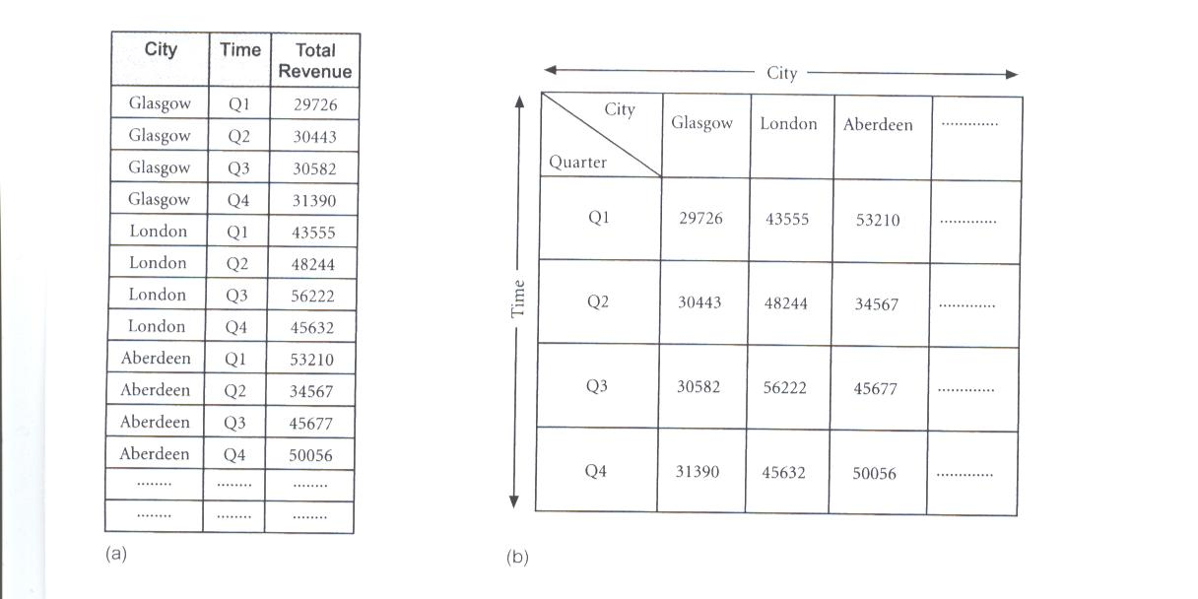
49
Representation of Multi-Dimensional Data
OLAP database servers use multi-dimensional structures to store data and relationships between data.
Multi-dimensional structures are best-visualized as cubes of data, and cubes within cubes of data. Each side of a cube is a dimension.

Slide 50
50
Representation of Multi-Dimensional Data
Multi-dimensional databases are a compact and easy-to-understand way of visualizing and manipulating data elements that have many inter-relationships.
The cube can be expanded to include another dimension, for example, the number of sales staff in each city.
The response time of a multi-dimensional query depends on how many cells have to be added on-the-fly.
As the number of dimensions increases, the number of cube’s cells increases exponentially.

Slide 51
51
From Tables and Spreadsheets to Data Cubes
A data warehouse is based on a multidimensional data model which views data in the form of a data cube
A data cube, such as sales, allows data to be modeled and viewed in multiple dimensions
Dimension tables, such as item (item_name, brand, type), or time(day, week, month, quarter, year)
Fact table contains measures (such as dollars_sold) and keys to each of the related dimension tables
An n-D base cube is called a base cuboid. The top most 0-D cuboid, which holds the highest-level of summarization, is called the apex cuboid. The lattice of cuboids forms a data cube.
Notes:
51

Slide 52
52
Cuboids Corresponding to the Cube
all
0-D(apex) cuboid
product
date
country
1-D cuboids
product,date
product,country
date, country
2-D cuboids
3-D(base) cuboid
product, date, country

Slide 53
53
Lattice of Cuboids
all
0-D(apex) cuboid
time
item
location
supplier
1-D cuboids
time,item
time,location
item,location
location,supplier
2-D cuboids
time,supplier
item,supplier
time,item,location
time,location,supplier
3-D cuboids
time,item,supplier
item,location,supplier
4-D(base) cuboid
time, item, location, supplier

Slide 54
54
OLAP Tools - Categories
OLAP tools are categorized according to the architecture used to store and process multi-dimensional data.
There are four main categories of OLAP tools as defined by Berson and Smith (1997) and Pends and Greeth (2001) including:
Multi-dimensional OLAP (MOLAP)
Relational OLAP (ROLAP)
Hybrid OLAP (HOLAP)
Specialized SQL Servers

Slide 55
55
Relational OLAP(ROLAP)
The Relational OLAP servers are placed between relational back-end server and client front-end tools.
To store and manage warehouse data the Relational OLAP use relational or extended-relational DBMS.
ROLAP is the fastest-growing type of OLAP tools.

Slide 56
56
Multidimensional OLAP (MOLAP)
Multidimensional OLAP (MOLAP) uses the array-based multidimensional storage engines for multidimensional views of data.
With multidimensional data stores, the storage utilization may be low if the data set is sparse.
Therefore many MOLAP Server uses the two level of data storage representation to handle dense and sparse data sets.

Slide 57
57
MOLAP tools use specialized data structures and multi-dimensional database management systems (MDDBMS) to organize, navigate, and analyze data.
MOLAP data structures use array technology and efficient storage techniques that minimize the disk space requirements through sparse data management.
The development issues associated with MOLAP:
Only a limited amount of data can be efficiently stored and analyzed.
Navigation and analysis of data are limited because the data is designed according to previously determined requirements.
MOLAP products require a different set of skills and tools to build and maintain the database.

Slide 58
58
The MOLAP storage mode causes the aggregations of the partition and a copy of its source data to be stored in a multidimensional structure in Analysis Services when the partition is processed.

Slide 59
59
Hybrid OLAP (HOLAP)
The hybrid OLAP technique combination of ROLAP and MOLAP both.
It has both the higher scalability of ROLAP and faster computation of MOLAP.
HOLAP server allows to store the large data volumes of detail data.
HOLAP tools deliver selected data directly from DBMS or via MOLAP server to the desktop (or local server) in the form of data cube, where it is stored, analyzed, and maintained locally is the fastest-growing type of OLAP tools.

Slide 60
60
Like MOLAP, HOLAP causes the aggregations of the partition to be stored in a multidimensional structure in an SQL Server Analysis Services instance.
HOLAP does not cause a copy of the source data to be stored.
For queries that access only summary data in the aggregations of a partition, HOLAP is the equivalent of MOLAP.

Slide 61
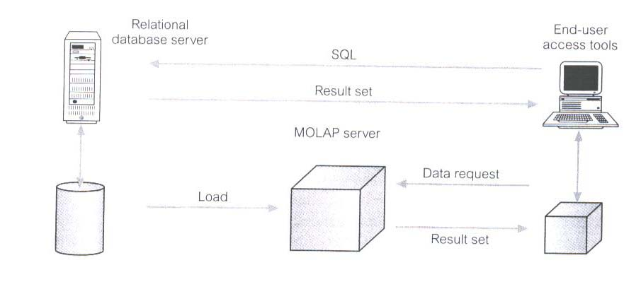
61

Slide 62
62
Specialized SQL Servers
specialized SQL servers provides advanced query language and query processing support for SQL queries over star and snowflake schemas in a read-only environment.

Slide 63
63
OLAP Operations
Roll-Up
Drill-Down
Slice & Dice
Pivot
Drill-Across
Drill-Through

Slide 64
64
Roll-Up Operation
This operation performs aggregation on a data cube in any of the following way:
By climbing up a concept hierarchy for a dimension
By dimension reduction.
The roll-up operation is performed by climbing up a concept hierarchy for the dimension location.
Initially the concept hierarchy was “street < city < state < country”.
On rolling up the data is aggregated by ascending the location hierarchy from the level of city to level of country.
The data is grouped into cities rather than countries.
When roll-up operation is performed then one or more dimensions from the data cube are removed.
Consider the diagram showing the roll-up operation

Slide 65
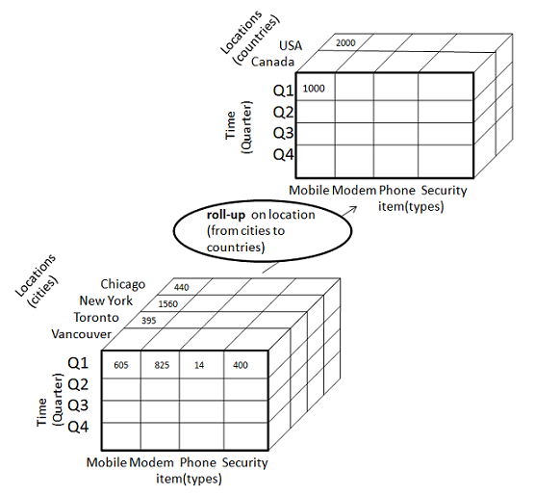

Slide 66
66
When roll-up is performed by dimension reduction, one or more dimensions are removed from the given cube.
For example, consider the sale data cube containing only two dimensions like location and time.
Roll-up may be performed by removing the time dimension, resulting in an aggregation of the total sales by location, rather than by location and by time.

Slide 67
67
Drill-down
Drill-down operation is reverse of the roll-up. This operation is performed by either of the following way:
By stepping down a concept hierarchy for a dimension.
By introducing new dimension.
The drill-down operation is performed by stepping down a concept hierarchy for the dimension time.
Initially the concept hierarchy was "day < month < quarter < year.”
On drill-up the time dimension is descended from the level quarter to the level of month.
When drill-down operation is performed then one or more dimensions from the data cube are added.
It navigates the data from less detailed data to highly detailed data.
Consider the diagram showing the drill-down operation:

Slide 68
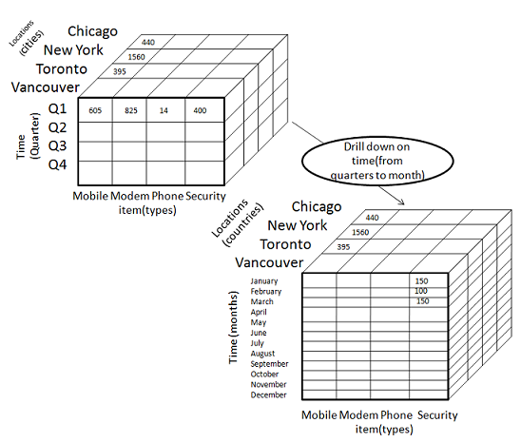
68
Drill-down

Slide 69
69
The resulting data cube details the total sales per month rather than summarizing them by quarter.
Because a drill down adds more detail to the given data,it can also be performed by adding new dimensions to a cube.
For example add dimension customer_group

Slide 70
70
Slice Operation
The slice operation performs selection of one dimension on a given cube and give us a new sub cube.
The Slice operation is performed for the dimension time using the criterion time ="Q1".
It will form a new sub cube by selecting one or more dimensions.
Consider the diagram showing the slice operation.

Slide 71
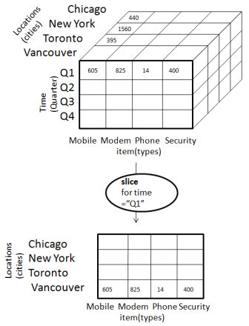

Slide 72
72
Dice Operation
The Dice operation performs selection of two or more dimension on a given cube and give us a new subcube.
The dice operation on the cube based on the following selection criteria that involve three dimensions.
(location = "Toronto" or "Vancouver“)
(time = "Q1" or "Q2“)
(item =" Mobile" or "Modem").

Slide 73
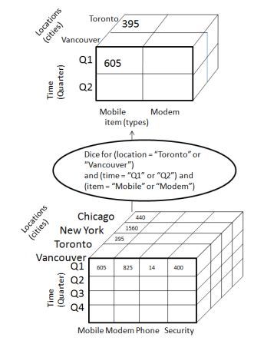

Slide 74
74
Pivot Operation
The pivot operation is also known as rotation.
It rotates the data axes in view in order to provide an alternative presentation of data.
Consider the diagram showing the pivot operation.

Slide 75
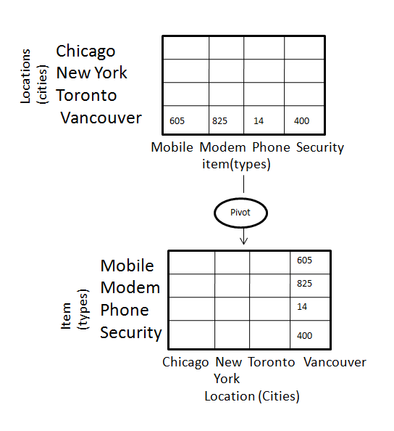

Slide 76
76
Other OLAP Operations
Drill-Across: Queries involving more than one fact table.
Drill-Through: Makes use of SQL to drill through the bottom level of a data cube down to its back-end relational tables.
Pivot (rotate): Pivot (also called "rotate") is a visualization operation which rotates the data axes in view in order to provide an alternative presentation of the data.

Slide 77
77
Data Warehouse vs. Operational DBMS
OLTP (on-line transaction processing)
Major task of traditional relational DBMS
Day-to-day operations: purchasing, inventory, banking, manufacturing, registration, accounting, etc.
OLAP (on-line analytical processing)
Major task of data warehouse system
Data analysis and decision making

Slide 78
78
User and system orientation: customer vs. market:
An OLTP is custom-oriented and is used for transaction and query processing by clerks, clients and information technology.
An OLAP is market oriented and is used for data analysis by knowledge workers, including managers,executive and analysis.
Data contents:
An OLTP manages current data that are too detailed and can be easily used for decision making.
An OLAP system manages large amount of historical data,provide facilities for summarization.
Database design
An OLTP uses ER-model and application oriented database design and an OLAP uses subject oriented database system.
View
An OLTP focuses on current data while OLAP focuses on historical data.

Slide 79
79
 | OLTP | OLAP
Characteristics | Operational processing | Informational processing
Orientation | Transaction | Analysis
users | clerk, IT & database professional | knowledge worker(manager)
function | day to day operations | decision support
DB design | application-oriented, ER-based | subject-oriented(star, snowflake)
data | current, up-to-date detailed, | historical, summarized, multidimensional
access | read/write index/hash on primary key | lots of scans, mostly read
unit of work | short, simple transaction | complex query
No.of users | thousands | Hundreds
DB size | 100 MB to GB | 100 GB to TB

Slide 80
80
Big Data Lakes
A data lake is a storage repository that holds a vast amount of raw data in its native format until it is needed. While a hierarchical data warehouse stores data in files or folders, a data lake uses a flat architecture to store data.

Slide 81
81
Big Data Lakes
During the development of a data warehouse, a considerable amount of time is spent analyzing data sources, understanding business processes and profiling data. The result is a highly structured data model designed for reporting. A large part of this process includes making decisions about what data to include and to not include in the warehouse. Generally, if data isn’t used to answer specific questions or in a defined report, it may be excluded from the warehouse. This is usually done to simplify the data model and also to conserve space on expensive disk storage that is used to make the data warehouse performant.
In contrast, the data lake retains ALL data. Not just data that is in use today but data that may be used and even data that may never be used just because it MIGHT be used someday. Data is also kept for all time so that we can go back in time to any point to do analysis.

Slide 82
82
Decision Support and OLAP
Information technology to help the knowledge worker (executive, manager, analyst) make faster and better decisions
What were the sales volumes by region and product category for the last year?
How did the share price of computer manufacturers correlate with quarterly profits over the past 10 years?
Which orders should we fill to maximize revenues?
Will a 10% discount increase sales volume sufficiently?
On-Line Analytical Processing (OLAP) is an element of decision support systems (DSS)
Notes:
82

Slide 83
References
https://www.blue-granite.com/blog/bid/402596/top-five-differences-between-data-lakes-and-data-warehouses

Slide 84
84
Thank You

